Slide 1









Dimensions of Complexity
flat or modular or hierarchical
explicit states or features or individuals and relations static or finite stage or indefinite stage or infinite stage fully observable or partially observable
deterministic or stochastic dynamics goals or complex preferences
single-agent or multiple agents
knowledge is given or knowledge is learned perfect rationality or bounded rationality

Slide 2










State-space Search
flat
or modular or hierarchical
explicit states
or features or individuals and relations
static or finite stage or
indefinite stage
or infinite stage
fully observable
or partially observable
deterministic
or stochastic dynamics
goals
or complex preferences
single agent
or multiple agents
knowledge is given
or knowledge is learned
perfect rationality
or bounded rationality

Slide 3








Decision Networks
flat
or modular or hierarchical
explicit states or features or individuals and relations static or finite stage or indefinite stage or infinite stage
fully observable or partially observable
deterministic or stochastic dynamics goals or complex preferences
single agent or multiple agents
knowledge is given or knowledge is learned perfect rationality or bounded rationality

Slide 4
Decision-theoretic Planning
flat
or modular or hierarchical
explicit states or features or individuals and relations
static or finite stage or
indefinite stage or infinite stage
fully observable
or partially observable
deterministic or stochastic
dynamics
goals or
complex preferences
single agent
or multiple agents
knowledge is given
or knowledge is learned
perfect rationality
or bounded rationality

Slide 5
Classical Game Theory
flat
or modular or hierarchical
explicit states
or features or individuals and relations
static or finite stage
or indefinite stage or infinite stage
fully observable or
partially observable
deterministic or stochastic
dynamics
goals or
complex preferences
single agent or
multiple agents
knowledge is given
or knowledge is learned
perfect rationality
or bounded rationality

Slide 6

Humans
flat or modular or
hierarchical
explicit states or features or individuals and relations
static or finite stage or
indefinite stage or infinite stage
fully observable or
partially observable
deterministic or stochastic
dynamics
goals or
complex preferences
single agent or
multiple agents
knowledge is given or
knowledge is learned
perfect rationality or
bounded rationality

Slide 7



The Dimensions Interact in Complex Ways
Partial observability makes multi-agent and indefinite horizon reasoning more complex
Modularity interacts with uncertainty and succinctness: some levels may be fully observable, some may be partially observable
Three values of dimensions promise to make reasoning simpler for the agent:
.., Hierarchical reasoning
.., Individuals and relations
.., Bounded rationality

Slide 8




Four Example Application Domains
Autonomous delivery robot
roams around an office
environment and delivers coffee, parcels,. . .
Diagnostic assistant helps a human troubleshoot problems and suggests repairs or treatments. E.g., electrical problems, medical diagnosis.

Slide 9
Domain for Delivery Robot
r131 r129 r127 r125 r123 r121 r119
r117
r115 r113
lab4 | lab3
lab1 | lab2
stairs
r101 r103 r105 r107 r109 r111

Slide 10





Autonomous Delivery Robot
Example inputs:
Abilities:
movement, speech, pickup and place objects.
Prior knowledge:
its capabilities, objects it may
encounter, maps.
Past experience:
which actions are useful and when,
what objects are there, how its actions affect its position.
Goals:
what it needs to deliver and when, tradeoffs
between acting quickly and acting safely.
Observations: about its environment from cameras, sonar, sound, laser range finders, or keyboards.

Slide 11







What does the Delivery Robot need to do?
Determine where Craig’s office is. Where coffee is. . . Find a path between locations.
Plan how to carry out multiple tasks.
Make default assumptions about where Craig is.
Make tradeoffs under uncertainty: should it go near the stairs?
Learn from experience.
Sense the world, avoid obstacles, pickup and put down coffee.

Slide 12
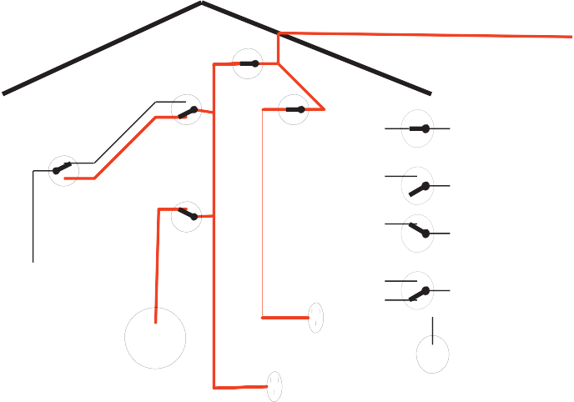
Domain for Diagnostic Assistant
outside power
cb1
s1
w5
w1
circuit breaker
s2
w2
cb2
w3
off
w0
s3
switch
on
w6
w4
p2
two-way switch
l1
p1
light
l2
power outlet

Slide 13





Diagnostic Assistant
Example inputs:
Abilities:
recommends fixes, ask questions.
Prior knowledge: how switches and lights work, how malfunctions manifest themselves, what information tests provide, the side effects of repairs.
Past experience: the effects of repairs or treatments, the
prevalence of faults or diseases.
Goals:
fixing the device and tradeoffs between fixing or
replacing different components.
Observations:
symptoms of a device or patient.

Slide 14







Subtasks for the diagnostic assistant
Derive the effects of faults and interventions.
Search through the space of possible fault complexes. Explain its reasoning to the human who is using it.
Derive possible causes for symptoms; rule out other causes.
Plan courses of tests and treatments to address the problems.
Reason about the uncertainties/ambiguities given symptoms.
Trade off alternate courses of action.
Learn what symptoms are associated with faults, the effects of treatments, and the accuracy of tests.

Slide 15




Common Tasks of the Domains
Modeling the environment Build models of the physical environment, patient, or information environment.
Evidential reasoning or perception Given observations,
determine what the world is like.
Action Given a model of the world and a goal, determine what should be done.
Learning from past experiences Learn about the specific case and the population of cases.

Slide 16
Representations
task
solve
problem
solution
represent
interpret
informal
formal
compute
representation
output

Slide 17




What do we want in a representation?
We want a representation to be
rich enough to express the knowledge needed to solve the task;
as close to the task as possible: compact, natural and maintainable;
amenable to efficient computation
.., able to express features of the task that can be exploited for computational gain
.., able to trade off accuracy and computation time and/or space
able to be acquired from people, data and past experiences.

Slide 18



Defining a Solution
Given an informal description of a task, what is a solution?
Typically much is left unspecified, but the unspecified parts can’t be filled in arbitrarily.
Much work in AI is motivated by common-sense reasoning. The computer needs to make common-sense conclusions about the unstated assumptions.

Slide 19





Quality of Solutions
Does it matter if the answer is wrong or answers are missing?
Classes of solution:
An optimal solution is a best solution according some measure of solution quality.
A satisficing solution is one that is good enough, according to some description of which solutions are adequate.
An approximately optimal solution is one whose measure of quality is close to the best theoretically possible.
A probable solution one that is likely to be a solution.

Slide 20



Decisions and Outcomes
Good decisions can have bad outcomes. Bad decisions can have good outcomes.
Information can be valuable because it leads to better decisions: value of information.
We can often trade off computation time and solution quality. An anytime algorithm can provide a solution at any time; given more time it can produce better solutions.
An agent isn’t just concerned about finding the right answer, but about acquiring the appropriate information, and computing it in a timely manner.

Slide 21
Solution quality and computation time
absolute
discounted quality
0
0.5
1
1.5
2
2.5 3 3.5
time
4
4.5
5
time discount

Slide 22
Choosing a Representation Language
We need to represent a task to solve it on a computer.
 problem



→ specification of problem
→ appropriate computation
Example representation languages: Machine Language, C++, Java, Prolog, Python, English

Slide 23
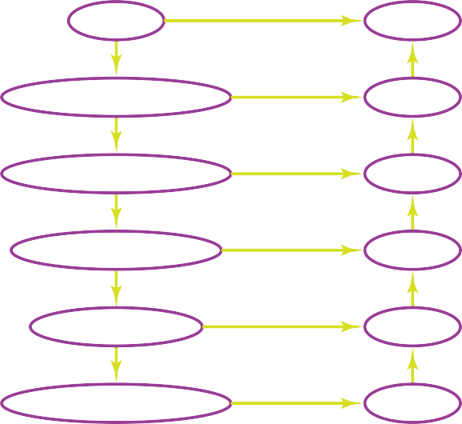
Hierarchy of representations
problem
high-level specification programming language assembly language digital circuit
currents and voltages
solution

Slide 24



Physical symbol system hypothesis
A
symbol
is a meaningful physical pattern that can be
manipulated.
A
symbol system
creates, copies, modifies and destroys
symbols.
Physical symbol system hypothesis:
A physical symbol system has the necessary and sufficient means for general intelligent action.

Slide 25


Knowledge & Symbol Levels
Two levels of abstraction seem to be common among biological and computational entities:
The knowledge level is in terms of what an agent knows and what its goals are.
The symbol level is a level of description of an agent in terms of what reasoning it is doing.
The knowledge level is about the external world to the agent. The symbol level is about what symbols an agent uses to implement the knowledge level.

Slide 26



Mapping from Problem to Representation
What level of abstraction of the problem to represent? What individuals and relations in the world to represent?
How can an agent represent the knowledge to ensure that the representation is natural, modular, and maintainable?
How can an agent acquire the information from data, sensing, experience, or other agents?

Slide 27




Choosing a level of abstraction
A high-level description is easier for a human to specify and understand.
A low-level description can be more accurate and more predictive. High-level descriptions abstract away details that may be important for actually solving the problem.
The lower the level, the more difficult it is to reason with.
You may not know the information needed for a low-level description.
It is sometime possible to use multiple levels of abstraction.

Slide 28



Reasoning and acting
Reasoning is the computation required to determine what an agent should do.
Design time reasoning and computation is carried out by the
designer the agent.
Offline computation
is the computation done by the agent
before it has to act.
Background knowledge and data "/' knowledge base .
Online computation is the computation that’s done by an agent between receiving information and acting.

